Slide 1
Software Security Testing & Validation–1
The OWASP Software Assurance Maturity Model (SAMM) undertakes software security testing & validation during the following phases:
Verification
Deployment

Slide 2
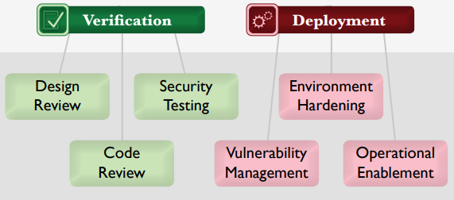
Software Security Testing & Validation–1

Slide 3
Software Security Testing & Validation–1
OWASP Software Assurance Maturity Model (SAMM) Verification Phase:
Design Review
Code Review
Security Testing

Slide 4
Software Security Testing & Validation–1
Design Review:
Focused on assessment of software design and architecture for security-related problems
Detect architecture-level issues early in software…

Slide 5
Software Security Testing & Validation–1
Design Review:
…development and thereby avoid potentially large costs from refactoring later due to security concerns

Slide 6
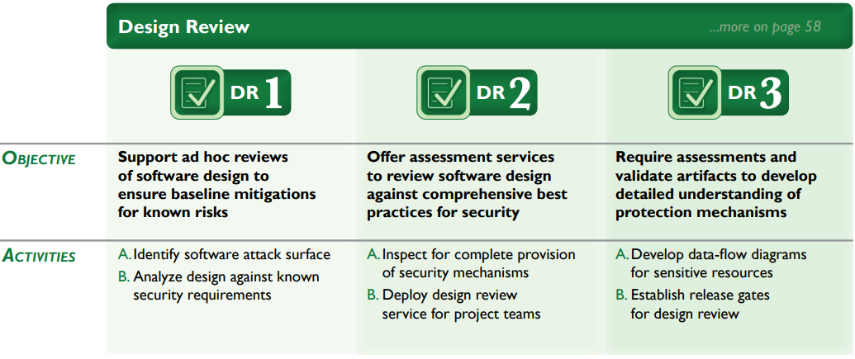
Software Security Testing & Validation–1

Slide 7
Software Security Testing & Validation–1
Code Review:
Focused on inspection of software at the source code level in order to find security vulnerabilities.
Code-level vulnerabilities are generally simple to understand…

Slide 8
Software Security Testing & Validation–1
Code Review:
…conceptually, but even informed developers can easily make mistakes that leave software open to potential compromise.

Slide 9
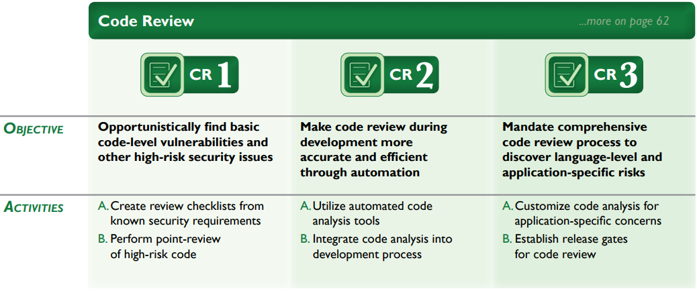
Software Security Testing & Validation–1

Slide 10
Software Security Testing & Validation–1
Security Testing:
Focused on inspection of software in the runtime environment in order to find security problems.
These testing activities bolster the assurance case for software by…

Slide 11
Software Security Testing & Validation–1
Security Testing:
…checking it in the same context in which it is expected to run, thus making visible operational misconfigurations or errors in business logic that are difficult to otherwise find.

Slide 12
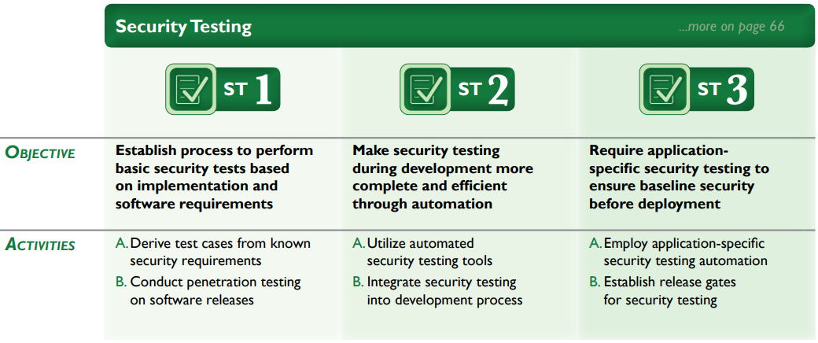
Software Security Testing & Validation–1

Slide 13
Software Security Testing & Validation–1
Lets look at SAMM Deployment Phase in the next module…

